Slide 1
Master Layout Design
Presented By:Er.Sudan Prajapati

Slide 2
Introduction
Using master pages is creating the common UI elements for all the web pages and create a consistent look and feel for whole website.
Dreamweaver also provides a similar feature in the form of Templates.
Consistent UI is the key to good user interface.
Before Master pages, the way we created consistent web pages was by using custom controls, CSS and JavaScript.
With master pages, ASP.NET relieves the developer from the burden of creating the consistent web pages.
Master pages not only provide the mechanism for creating consistent web pages, but also give us a centralized way of changing the UI elements that need to be changed across all the pages of the website.

Slide 3
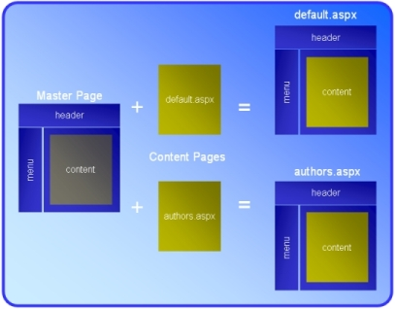
Visualizing the Master page

Slide 4
Use of Master Page
Creating a set of controls that are common across all the web pages and attaching them to all the web pages.
A centralized way to change the above created set of controls which will effectively change all the web pages.
Dynamically changing the common UI elements on master page from content pages based on user preferences.

Slide 5
Terminology
Masterpage: Gives us a way to create common set of UI elements that are required on multiple pages of our website.
ContentPage: The ASP.NET web page that will use master page to have the common UI elements displayed on rendering itself.
ContentPlaceHolder: A control that should be added on the MasterPage which will reserve the area for the content pages to render their contents.
ContentControl: A control which will be added on content pages to tell these pages that the contents inside this control will be rendered where the MasterPage's ContentPlaceHolder is located.

Slide 6
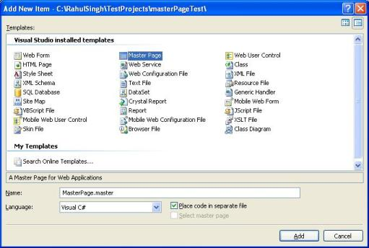
Creating a MasterPage
Go to "Add New Item".
Select the MasterPage

Slide 7
Let's say our master page is MasterPageOne.Master.
We will now add a menu bar on this master page on top of the page.
This Menu bar will be common to all the pages (since it is in Masterpage).
Once we have menubar added, we can have content pages use the master page.
Let's add few content pages like default.aspx, about.aspx, Contact.aspx.
When we add these content pages, we need to remember to select the option of "Use master Page".

Slide 8
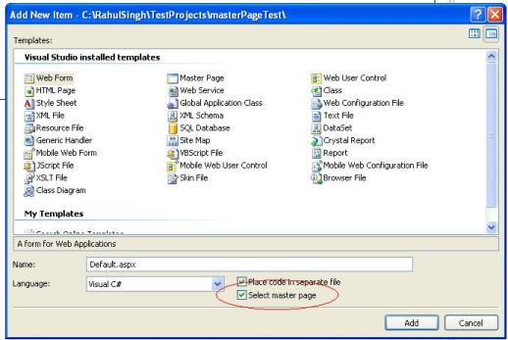

Slide 9
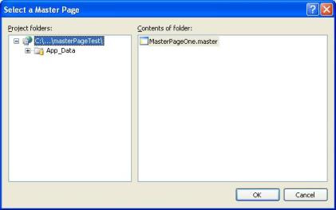

Slide 10
When we look at the MasterPage we will see that masterpage has a ContentPlaceHolder control.
All the code that is common for the content pages is outside the ContentPlaceHolder control

Slide 11
External CSS
Right Click on the project add new folder
Name folder CSS
Add new Item named stylesheet.
Open the Style Sheet (Default is StyleSheet.css)
From the view->toolbar -> add stylesheet

Slide 12

In tool bar section you will see this portion click in highlighted section.
Then a popup window will appear.

Slide 13
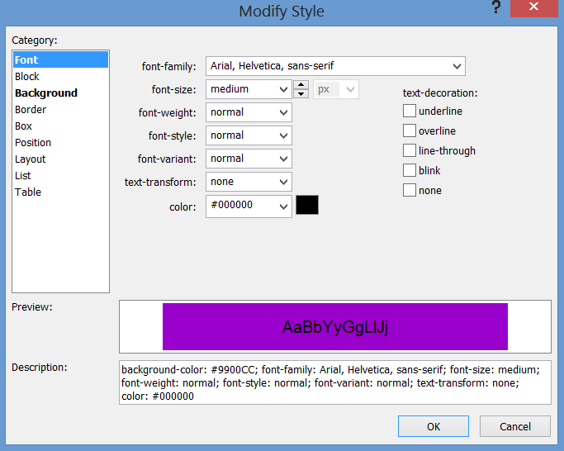
Add CSS as you like

Slide 14
Style Menu – Add Style Rule
In the Add Style Rule dialog box, select one of the following CSS selectors and then click OK.
Open the master page .
In Head section drag an drop the css file

